Slide 1
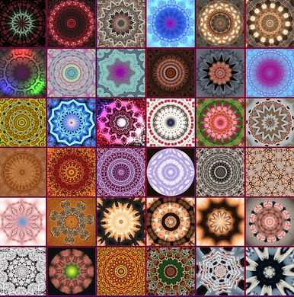
Ditch Optimism Bias and Strategic Misrepresentation for the Pluralistic Organization? Time to Move the Debate Forward
Nuno Gil
Professor of New Infrastructure Development
Research Director and Co-founder, Centre for New Infrastructure Development
The University of Manchester
© Nuno A. Gil. All Rights Reserved
Notes:
Like a kaleidoscope in which the view changes as it is rotated, any collaboration can be transformed as issues are addressed in this way

Slide 2
Motion: Treasury’s optimism bias policy has been a disservice to efforts to create high-performance projects
© Nuno A. Gil. All Rights Reserved

Slide 3
Project [as an organization] is: a temporary multi-agent system of coordinated action with identifiable goals and boundaries
but also…the subject of such a task
© Nuno A. Gil. All Rights Reserved

Slide 4
Authority hierarchies legitimized by ownership stakes (firm), regulation (government), employer-employee relationships Markets legitimized by legal contracts; how to ‘buy’ collaboration Clans and meritocracy-based authorities legitimized by homogeneity of logics, backgrounds, beliefs, kinship
Conventional Organizational Structures
© Nuno A. Gil. All Rights Reserved

Slide 5
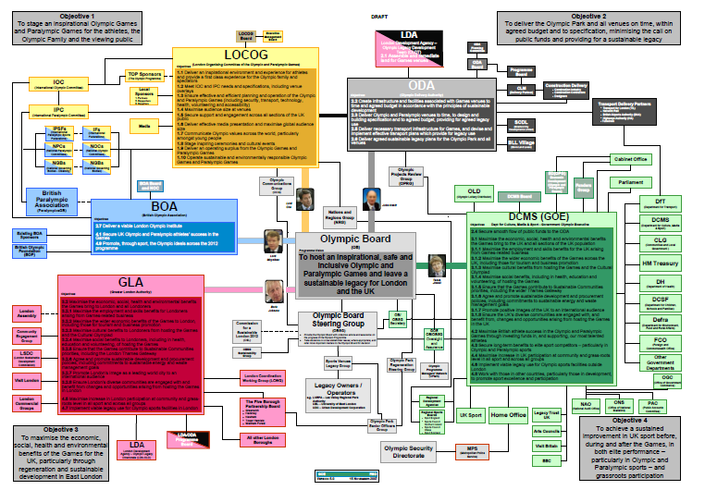
Where does the major project fit?
© Nuno A. Gil. All Rights Reserved

Slide 6
In the realm of social dilemmas!
Excludability from using the designed artifact | Subtractability (rivalry) of preferences for the final design choices
 | Low (Modular Design) | High (Integral Design)
High (Individual) | Individuals assemble their own systems of modules Personal computer, personal library, personal wardrobe, photo album | Private goods: producers design indivisible templates with modular variants; or users design for themselves Coffee-maker, hand-knitted sweater, single-family house
Low (Shared) | Individuals share modules and/or modular/mix-and- match designs Social networks, open source software, public library | Social dilemma! Indivisible designed artifacts to be shared in use by many heterogeneous stakeholders Project-based collaborative networks to deliver public services and infrastructure
© Nuno A. Gil. All Rights Reserved

Slide 7
Implications
© Nuno A. Gil. All Rights Reserved

Slide 8
Structure
© Nuno A. Gil. All Rights Reserved

Slide 9
At the core: a collective action problem
The core is porous, coalition-led
Governance at the core is ‘flat’
Heterogeneous claimants
High rivalry and conflict
It’s either/or…but people wish it was and/both
(...)
(...)
(...)
©Nuno A. Gil, All Rights reserved

Slide 10
At periphery: how to ‘buy’ collaboration?
Periphery is closed
Use of competitive bidding/market to find partners
Use of legal contracts to simulate hierarchy
Need to evolve from ‘arranged marriage’ into sustainable long-term relationship VERY, VERY DIFFICULT!!
(...)
(...)
(...)
©Nuno A. Gil, All Rights reserved

Slide 11
Performance
© Nuno A. Gil. All Rights Reserved

Slide 12
Traditional Performance Definition
Fixed scope + on time + within budget rooted in unitary organization /authority hierarchy assumption
Gantt charts --- developed for scheduling factory work in early 1900s
CPM developed by DuPont in the 40s.
PERT/Earned value … developed by the US Navy in the 50s
Monte Carlo… invented in the 40s to plan nuclear weapons projects
© Nuno A. Gil. All Rights Reserved

Slide 13
Against this definition, major projects consistent underperform
© Nuno A. Gil. All Rights Reserved

Slide 14
Common explanations & implications
Strategic misrepresentation (‘lying’)
Optimism bias (‘technical incompetence’)
Lack of planning (‘managerial incompetence’)
Buyer-supplier flexible contracts
Humongous contingency & controls
Training
Alliancing, NEC option C
Lean management stuff
Time to move the debate forward!!
© Nuno A. Gil. All Rights Reserved

Slide 15
Collaboration
© Nuno A. Gil. All Rights Reserved

Slide 16
Antecedents of Collaboration
Higher-order goal unifying autonomous stakeholders
Interdependence of resources
Prior history of working together (‘familiarity breeds trust’)
Long-term relationships (‘shadow of the future’)
Face-to-face interaction
Convenor with authority to intervene (‘honest broker’)
© Nuno A. Gil. All Rights Reserved

Slide 17
Urgency is at odds with consensus
Consensus cannot be rushed
Large groups need more time to deliberate
Large , heterogeneous groups need even more time
But in project-based work collaborative process is time-bound
Hence risk is real that collaboration unravels
impasse, defections, deferred commitments, free-riding, ‘white elephants’
© Nuno A. Gil. All Rights Reserved

Slide 18
Cooperative Types in General Human Population [Kurzban and Houser 2005, p.1803]
Complicating matters we’ve people…
Cooperators (13% of general population) contribute to others at a cost to themselves, uninfluenced by others’ contribution. This behavior resembles pure altruism
Reciprocators (63%) may contribute to others at a cost to themselves, but only insomuch that others are also contributing. Such behavior suggests reciprocity.
Free riders (20%) contribute significantly less than others (but usually more than nothing) regardless of others’ contributions. This behavior fits the image of a narrowly self-interested individual.
The remaining 4% are too inconsistent to be categorized
© Nuno A. Gil. All Rights Reserved

Slide 19
Where does this leave us?
© Nuno A. Gil. All Rights Reserved

Slide 20
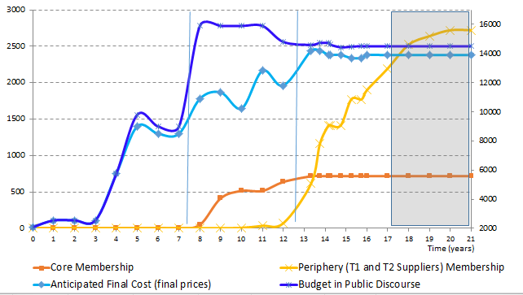
Rethink how we define performance
Ideation
Planning
Implementation
© Nuno A. Gil. All Rights Reserved

Slide 21
And for as long as we remain stuck…
Let’s create structures to bring out the best of people in consensus-oriented organizations
© Nuno A. Gil. All Rights Reserved

Slide 22
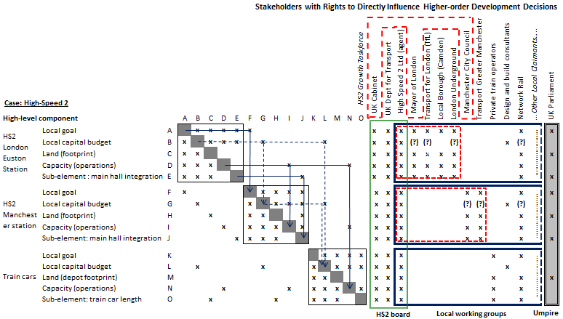
Polycentric Governance
Let problem-solving fluctuate through relationships of deference!
© Nuno A. Gil. All Rights Reserved

Slide 23
Nested structure of umpires
Umpires must hold moral high-ground by being impartial and evidence-based
© Nuno A. Gil. All Rights Reserved

Slide 24
And going back to our motion…
Don’t ditch major project contingencies …you need organizational slack to cope with individual claims without undermining public legitimacy
But risk is real of a self-fulfilling prophecy
So there’s a trade-off !
© Nuno A. Gil. All Rights Reserved

Slide 25
Final Thought
Collective action is always a struggle...but evidence gives us reasons to be optimistic
© Nuno A. Gil. All Rights Reserved

